Slide 1
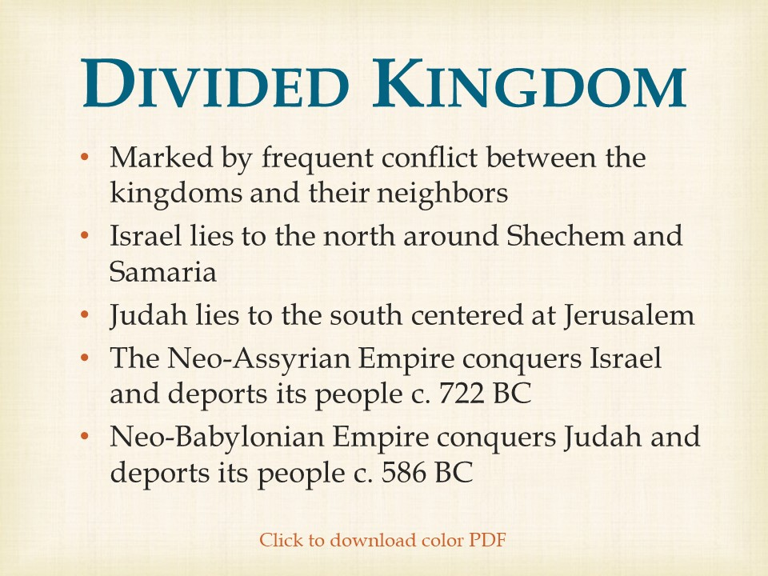

Slide 2
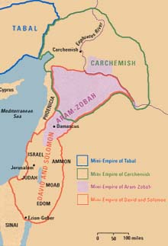
The United Empire
In the absence of an overarching military power in the Near East from 1200–900 B.C., regional empires flourished in the Levant and surrounding areas. On the Anatolian peninsula, Tabal arose from the remains of the dwindled Hittite empire; to its east in northern Syria, Carchemish blossomed. Aram-Zobah later extended from the Biqa Valley in modern Lebanon south to the Galilee and north to Damascus and the Euphrates. The mini-empire of David and Solomon at its height came to dominate the Aram-Zobah empire as far north as the Euphrates, as recorded in 2 Samuel 8 and 10, and controlled territory from the Mediterranean to Edom, Moab and Ammon east of the Jordan and south to the Gulf of Aqaba. With the consolidation of power in Assyria under Ashurnasirpal II (883–859 B.C.), however, the era of mini-empires in the ancient Near East came to an abrupt close.
Biblical Archaeology Review 27:5, September/October 2001
How We Know When Solomon Ruled

Slide 3
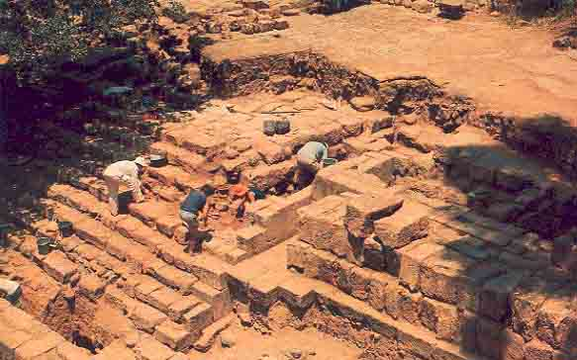
The High Place at Dan
Israelite “high place.” Volunteers armed with trowels and brushes clear the monumental staircase leading to a raised stone platform referred to as a bamah, Hebrew for “high place.”
The bamah, the central cult site of Israelite Dan, dates from the end of the tenth century B.C. and continued in use to the eighth century B.C, the period of the Divided Monarchy. Biran suggests that the bamah was part of the religious sanctuary built at Dan by Jeroboam.
Thus far no trace of the famed golden calf that Jeroboam erected at Dan (1 Kings 12:29) has come to light. Biran suspects that earlier Israelite and even Canaanite shrines may remain buried somewhere beneath the later structures of the cultic enclosure, or temenos.
1 Kings 12:28-29
“…the king (Jeroboam) made two golden calves… One he set up in Bethel, and the other in Dan…”
Biblical Archaeology Review 13:4, July/August 1987
BAR Interview: Avraham Biran—Twenty Years of Digging at Tel Dan

Slide 4
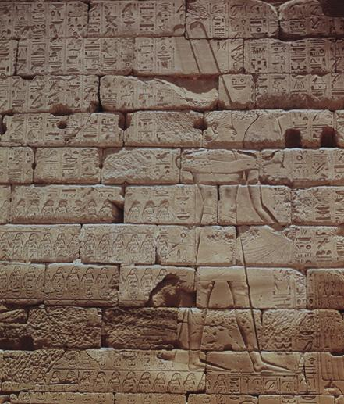
Pharaoh Shoshenq (Shishak) Takes Solomon’s Gold
1 Kings 14:25-26
“In the fifth year of King Rehoboam, Shishak king of Egypt attacked Jerusalem. He carried off the treasures of the temple of the Lord and the treasures of the royal palace. He took everything, including all the gold shields Solomon had made.”
On returning to Egypt, he had the victory stela above carved on a wall in the Temple of Amun at Karnak. The existence of a system of defenses during, or somewhat after, the reign of David—and well away from the capital in Jerusalem—indicates the presence of an Israelite nation in the mid-tenth century B.C.E.
Bible Review 11:6, December 1995
Erasing History

Slide 5
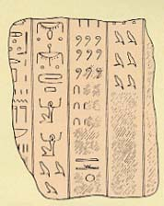
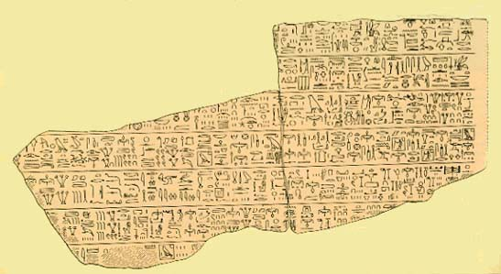
Shoshenq’s Son Records Gifts to the Gods
Gifts to the gods recorded by King Osorkon I of Egypt in 921 B.C. include an astonishing 383 tons of gold and silver. This fragment from a pillar in a temple at Bubastis, shows itemized lists of gifts to each god and goddess of Egypt.
The hieroglyphs indicate numbers—part of the tally of this vast gold treasure. Each upside down “U” stands for 10; each curl above them stands for 100. The “tadpoles” or “bird-shaped” figures at the bottom of the second column and at the top of the last column on the right represent 100,000 each, and the people with upraised arms are each symbols for 1,000,000.
Biblical Archaeology Review 15:3, May/June 1989
Does the Bible Exaggerate King Solomon’s Golden Wealth?

Slide 6
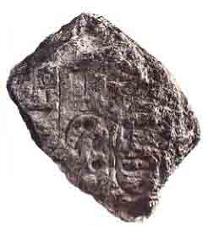
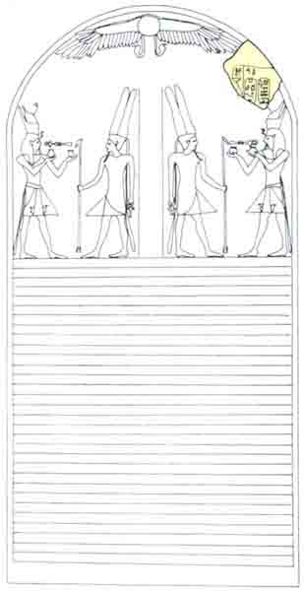
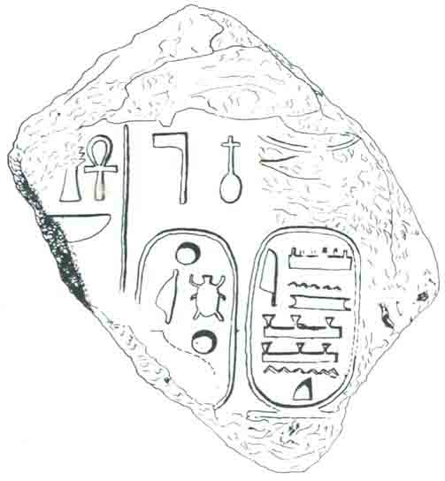
Pharaoh Shishak’s Stele
Dating to about 925 B.C.E. and recovered at Megiddo, this 15-inch stone fragment reads, “Bright is the form of the [sun-god] Re” and “Amun’s beloved, Shishak [I].” As 1 Kings 14:25–26 records, Shishak “marched against Jerusalem and carried off the treasure of the house of the Lord and the treasures of the royal palace.” According to an inscription at Karnak, in Upper Egypt, the Pharaoh then turned north, conquering several cities; this stele and the Karnak inscription indicate that Megiddo (Armageddon) was one of them, although it may have surrendered without a fight. If he had destroyed this city, he probably would not have erected a victory stele at the site.
Biblical Archaeology Review 20:1, January/February 1994
Back to Megiddo
Biblical Archaeology Review 38:4, July/August 2012
Did Pharaoh Sheshonq Attack Jerusalem?

Slide 7
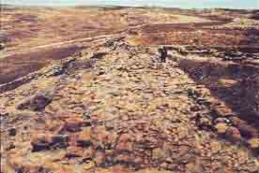
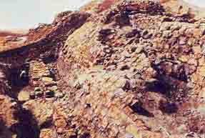
King Asa’s Wall
1 Kings 15:22
“Then King Asa issued an order to all Judah—no one was exempt—and they carried away from Ramah the stones and timber Baasha had been using there. With them King Asa built up Geba in Benjamin, and also Mizpah.”
A 15-foot-thick wall protected Mizpah during the period of the Divided Monarchy, when the city lay on the border between Israel in the north and Judah in the south. According to the Bible, when King Baasha (906 to 883 B.C.) of Israel invaded Judah, King Asa encouraged the ruler of Damascus to attack Baasha from the north. Baasha fled, leaving behind stones, timber and other supplies that Asa used to fortify Mizpah.
Biblical Archaeology Review 23:5, September/October 1997
Mizpah: Newly Discovered Stratum Reveals Judah’s Other Capital

Slide 8
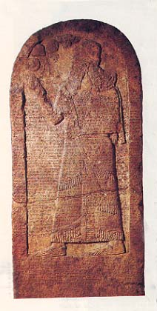
King Ahab
1 Kings 20:15
“So he (Ahab) mustered the aids of the provincial governors, 232 strong, and then he mustered the troop - all the Israelites - 7,000 strong.”
Discovered at Kurkh on the Tigris River in southeastern Turkey, this 7.2-foot-high stela depicts Shalmaneser III facing the symbols of the gods Assur (the winged disk), Ishtar (the star), Anu (the horned miter) and Sin (the disk and crescent), and contains 102 lines of cuneiform text giving an account of the first six years of Shalmaneser’s reign. The text describes the battle of Qarqar, where Shalmaneser defeated a coalition of seacoast kings in 853 B.C.E., a coalition including “Ahab the Israelite,” who made the largest contribution of 10,000 foot soldiers and 2,000 chariots. This reference deepens the enigma of Shalmaneser’s identification of Jehu as “son of Omri” on the Black Obelisk. The Assyrians knew about Ahab and referred to him as an “Israelite”—not as “son of Omri,” which in fact he was. Therefore, author Schneider argues, “son of Omri” probably was not a general phrase for Israelite.
Biblical Archaeology Review 21:1, January/February 1995
Did King Jehu Kill His Own Family?

Slide 9
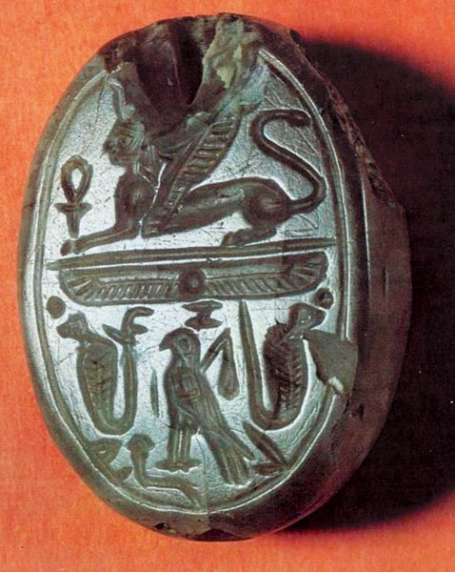
Ahab and Jezebel
1 Kings 16:31
“Not content to follow the sins of Jeroboam son of Nebat, he [Ahab] took as wife Jezebel daughter of King Ethbaal of the Sidonians…”
Belonging to a queen? Elaborately decorated with symbols and letters, this stone seal undoubtedly belonged to a member of the upper class. The seal was part of a private collection that was donated to the Israel Department of Antiquities in the early 1960s. Its unusually large size (it is 1.25 inches long), and common Egypto-Phoenician symbols of royalty and divinity strongly suggest that it belonged to a king or queen.
Biblical Archaeology Review 34:2, March/April 2008
Fit for a Queen: Jezebel’s Royal Seal

Slide 10
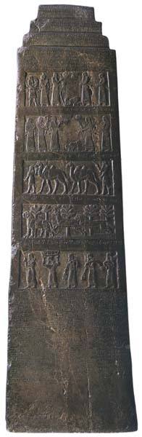
The Black Obelisk
A kingly chronicle. Discovered in 1846 by Austen Henry Layard at Nimrud, on the Tigris River in modern Iraq, this four-sided, 6.5-foot-high stone stela, known as the Black Obelisk, is carved with five rows, or registers, of relief sculptures. Each register wraps around the stela’s four sides and depicts the tribute of a different kingdom—identified by a line of cuneiform script above the register—to the Assyrian king Shalmaneser III. The second register from the top portrays the tribute of a prostrate “Jehu, son of Omri,” a rare reference to an Israelite king in historical records. Dating to 841 B.C.E., the stela displays 190 lines of text describing 31 military campaigns conducted by Shalmaneser, including forays to the Mediterranean, Cilicia in Asia Minor, Media (modern Iran), Babylonia and the Persian Gulf.
Biblical Archaeology Review 21:1, January/February 1995
Did King Jehu Kill His Own Family?

Slide 11
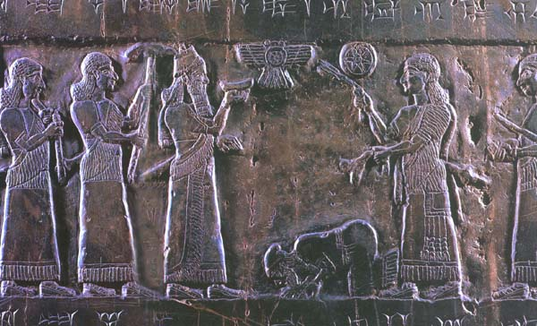
King Jehu Usurps The Throne
“Tribute of Jehu, Son of Omri,” reads the cuneiform caption over the panel, the second register from the top of the Black Obelisk. The panel depicts the Israelite king Jehu (ruled 841–814 B.C.E.) or one of his emissaries prostrating himself before the Assyrian king Shalmaneser III, who ruled from 858 to 824 B.C.E. Symbols of the gods Assur (the winged disk) and Ishtar (the star) hover above the obeisant figure. Three other panels, one on each side of the stela, show Israelites offering tribute that includes tin, gold and silver objects, and javelins. Although the Bible never mentions Shalmaneser, it tells us that Jehu was a usurper who killed Omri’s descendants
(2 Kings 9:14; 10:4).
First depiction of a King of Israel
2 Kings 10:11
“So Jehu slew all that remained of the house of Ahab…”
Biblical Archaeology Review 21:1, January/February 1995
Did King Jehu Kill His Own Family?

Slide 12
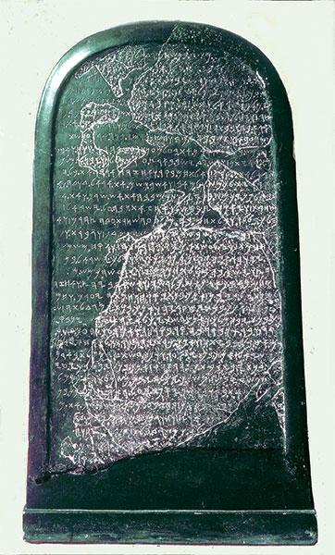
King Mesha of Moab
The Moabite Stone
Broken into hundreds of pieces, this Moabite stele details the accomplishments of King Mesha, including his rebellion against the armies of Israel. While the account differs from the Biblical narrative (2 Kings 3), the Mesha stele names “Omri, king of Israel.” The 34-line text, which conatins the earliest extra-Biblical reference to the god of the Israelites, may also mention the “House of David,” according to epigrapher André Lemaire.
Biblical Archaeology Review 40:2, March/April 2014
Archaeology Confirms 50 Real People in the Bible
Biblical Archaeology Review 43:3, May/June 2017
Whom Do You Believe—The Bible or Archaeology?
Biblical Archaeology Review 37:3, May/June 2011
The Birth & Death of Biblical Minimalism

Slide 13
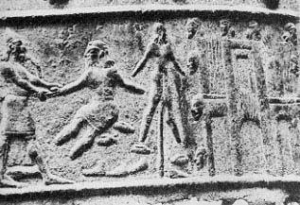
King Joash
2 Kings 13:10
“Joash the son of Jehoahaz became king over Israel in Samaria, and reigned sixteen years.”
Tell al-Rimah Stela
An inscription on a stela from Tell al Rimah in northern Iraq, erected in 806 B.C. by Assyrian king Adad-nirari III, informs us that Jehoahaz, king of Israel (814–798 B.C.), paid tribute to the Assyrian king: “He [Adad-nirari III of Assyria] received the tribute of Ia’asu the Samarian Uehoahaz, king of Israel], of the Tyrian (ruler) and the Sidonian (ruler).”
Stephanie Page, “A Stela of Adad-nirari III and Nergal-eres from Tell al Rimah,” Iraq 30 (1968), p. 143.
Dismembered and displayed, the victims of Shalmaneser III (858–824 B.C.) become grisly ornaments, as shown in this detail from a bronze relief that once decorated the wooden gates of a temple or palace at Balawat, near modern Mosul. Severed heads hang from the walls of Kulisi, at right, as flames (represented by parallel vertical lines) consume this ancient city near the source of the Tigris River. Beside the city we see a prisoner, bereft of hands and feet, impaled on a stake. At left, an Assyrian soldier grasps the hand of a captive whose other hand and feet have been cut off. Dismembered hands and feet litter the ground.
Biblical Archaeology Review 17:1, January/February 1991
Grisly Assyrian Record of Torture and Death

Slide 14
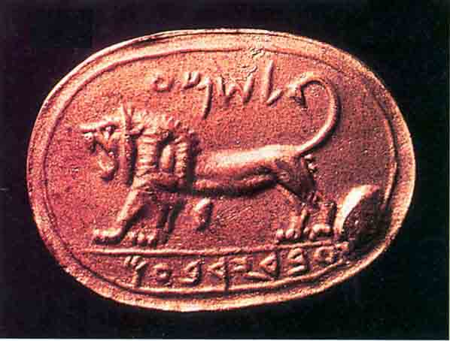
King Jeroboam II
2 Kings 14:23
“In the fifteenth year of King Amaziah son of Joash of Judah, King Jeroboam son of Joash of Israel became king of Samaria – for forty one years.”
The Shema Seal. A fearsome lion was carved into an eighth-century B.C.E. jasper seal, found at Megiddo, inscribed “[Belonging] to Shema servant of Jeroboam.” The seal impression shown here is a replica. The original was discovered at the beginning of this century when Palestine was under Ottoman rule and was presented to the Sultan in Constantinople; it later disappeared, and its whereabouts today remain a mystery.
The owner of that original seal, one Shema, probably served Jeroboam II, king of the northern kingdom of Israel from 784 to 748 B.C.E. A number of seals and one seal impression referring to eighth-century B.C.E. kings have turned up—attesting, for example, to kings Uzziah (769–733 B.C.E.) and Hezekiah (727–698 B.C.E.) of the southern kingdom of Judah—though none of these seals actually belonged to a king.
Biblical Archaeology Review 21:6, November/December 1995
Royal Signature: Name of Israel’s Last King Surfaces in a Private Collection

Slide 15
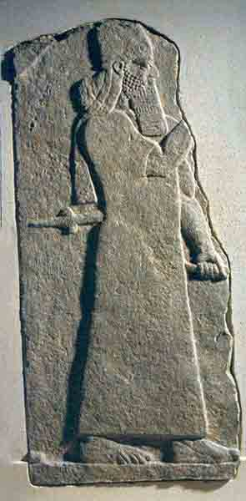
Tiglath-Pileser III (Pul) King of Assyria
“I overwhelmed him … and he … fled like a bird, alone,” the Assyrian king Tiglath-pileser III (reigned 745–727 B.C.E.) poetically boasts in an Assyrian annal describing his defeat of King Menahem of Israel (reigned 747–737 B.C.E.). Menahem paid 1,000 talents of silver to retain his throne and became a vassal of Assyria. Tiglath-pileser is shown here in an eighth-century B.C.E. limestone relief from his palace at Nimrud.
The Assyrians’ conquest of Israel is also described in the Bible, which tells of Tiglath-pileser’s invasion of Israel and his alliance with Ahaz of Judah, who refused to join Israel in battle against the Assyrians (2 Kings 15:19, 29, 16:7–9): “In the time of Pekah king of Israel, Tiglath-pileser king of Assyria came and took Iyon, Abel Beit-Maachah, Yanoah, Kedesh and Hazor. He took Gilead and Galilee, including all the land of Naphtali, and deported the people to Assyria” (2 Kings 15:29).
Rembrandt
Biblical Archaeology Review 24:3, May/June 1998
Israel in Exile

Slide 16
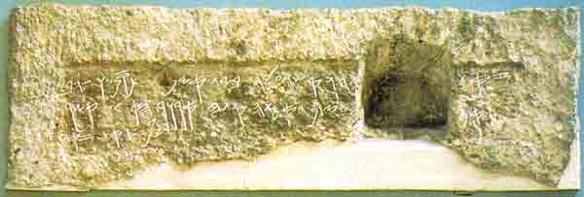
Tomb of Shebna
8-7th Century BC
“Cursed be the Man who will open this,” warns an inscription that was placed over the entrance to a tomb on a cliff overlooking Jerusalem. The tomb was discovered in 1870 by the French diplomat and archaeologist Charles Clermont-Ganneau, who was unable to read the inscription. He chiseled it out of the rock and sent it to the British Museum, where it still resides.
The name of the occupant has mostly been lost, except for the theophoric ending “-yahu,” but he is described as being “over the house.” In a 1953 article, the great epigraphist Nahman Avigad convincingly demonstrated that this tomb belonged to Shebnayahu, or Shebna, the steward in King Hezekiah’s palace whom Isaiah castigates for having an elaborate tomb hewn for himself, “an abode on the cliff”
Biblical Archaeology Review 35:3, May/June 2009
Tracking Down Shebnayahu, Servant of the King
Biblical Archaeology Review 20:3, May/June 1994
The Tombs of Silwan

Slide 17
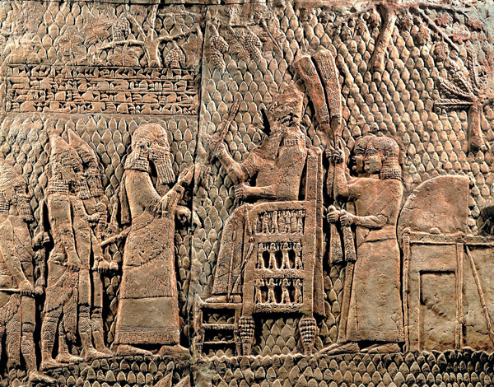
The Battle of Lachish
The Assyrian king Sennacherib (705–681 B.C.E.) sits high on his throne in a relief depicting his conquest of the Judahite town of Lachish in 701 B.C.E. In that year Sennacherib rampaged through Judah, destroying Jewish towns but failing to capture Jerusalem. His invasion was a catastrophe for Judah but a boon for archaeologists like author Oded Borowski, who uses the destruction layer to piece together important details about life in the time of King Hezekiah, ruler of Judah during Sennacherib’s invasion.
“I laid waste the large district of Judah and made the overbearing and proud Hezekiah, its king, bow in submission,” boasts Sennacherib, monarch of Assyria, in a preserved cuneiform inscription. “I laid siege to 46 of his strong cities: ... and conquered (them),”
Biblical Archaeology Review 31:3, May/June 2005
In the Path of Sennacherib

Slide 18
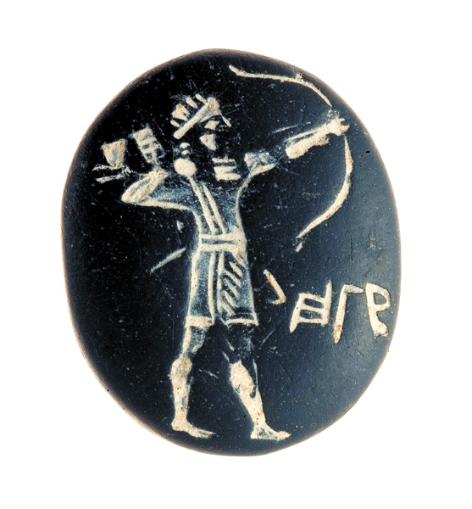
Judean Archer
Isaiah 7:24
“Hunters will go there with bow and arrow, for the land will be covered with briers and thorns.”
This phosphorite seal bearing an elegant image of an Assyrian-style archer prepared to shoot is one of several First Temple period seals that were found in the rubble of the four-room house. Despite the Assyrian artistry, the inscription is in Hebrew and identifies its owner: l’Hagav, or “[belonging] to Hagav.”
Biblical Archaeology Review 38:1, January/February 2012
Layers of Ancient Jerusalem
Notes:
‹#›

Slide 19
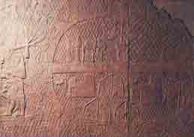
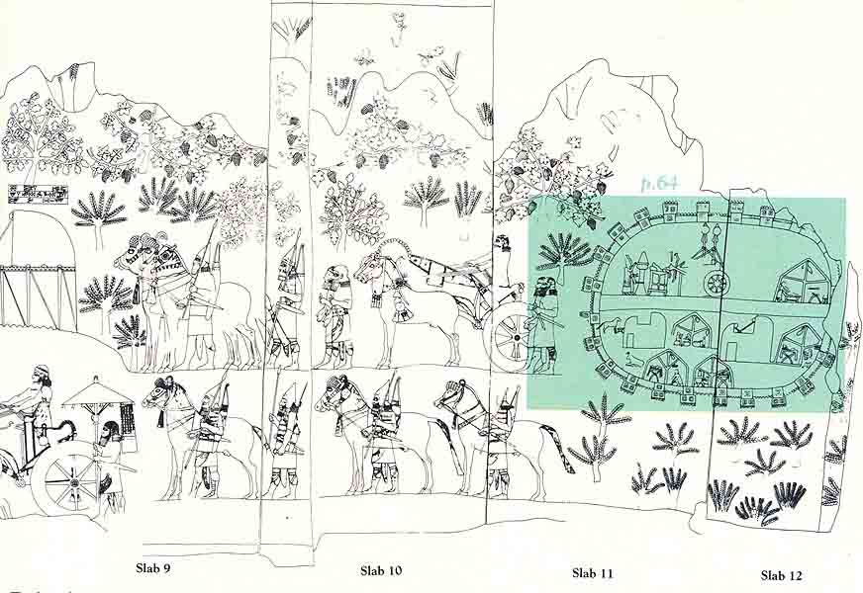
Sennacherib’s Camp Depicted on Lachish Relief
Assyrian fortified camp marks the end of the series of relief slabs at the right hand side. The relief artist has presented a bird’s eye view of the fortifications and a frontal view of the elements inside the camp: people, animals and tents. A wide thoroughfare bisects the camp horizontally.
Biblical Archaeology Review 10:2, March/April 1984
Destruction of Judean Fortress Portrayed in Dramatic Eighth-Century B.C. Pictures

Slide 20
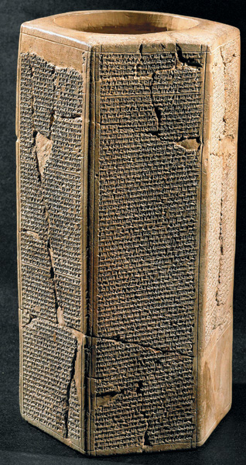
Sennacherib’s Prism
King of Assyria 705 – 681 BC
Both Sennacherib’s account and the Biblical accounts are clear, however, that Sennacherib (705–681 B.C.E.) was unable to capture the prize, although he had it under siege: Jerusalem. According to the Bible, Jerusalem was saved by a miracle. No explanation is given by Sennacherib—only that he “made [Hezekiah] a prisoner in Jerusalem, his royal residence, like a bird in a cage.” Sennacherib apparently was unable to break into the birdcage, however.
Biblical Archaeology Review 31:3, May/June 2005
In the Path of Sennacherib
Biblical Archaeology Review 20:3, May/June 1994
The Tombs of Silwan
Notes:
‹#›

Slide 21
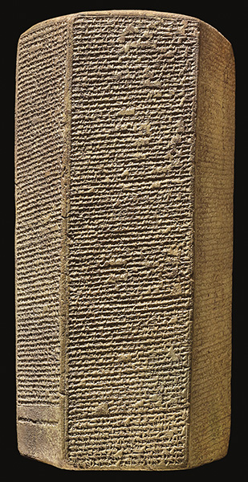
Manasseh
ESARHADDON PRISM. The text Nineveh A recounts the story of Esarhaddon’s rise to power and rule. Even though Esarhaddon is not the oldest son of his father Sennacherib, he is nevertheless made Sennacherib’s heir apparent—to the chagrin of his older brothers. Jealous, his brothers try to undermine him, and Esarhaddon is forced to take refuge away from the capital Nineveh. After his brothers treacherously murder their father, Esarhaddon returns and claims the throne. Dated to 673–672 B.C.E., the Esarhaddon Prism at the British Museum preserves a copy of Nineveh A. Made of clay, the prism has a flat base and slightly convex top.
Biblical Archaeology Review 42:3, May/June 2016
“And His Brothers Were Jealous of Him”: Surprising Parallels Between Joseph and King Esarhaddon of Assyria

Slide 22
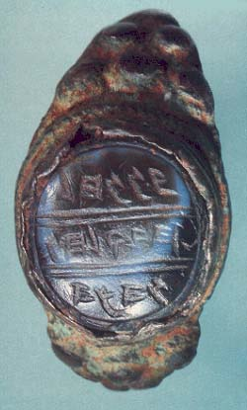
Hanan’s Ring
The ring seal is another example; it reads “Belonging to Hanan son of Hilqiyahu the priest.” Some scholars suggest that this Hilqiyahu may be the Biblical priest Hilkiah, who served during the reign of the seventh-century king Josiah (2 Kings 22:4).
Biblical Archaeology Review 27:3, May/June 2001
Pagan Yahwism: The Folk Religion of Ancient Israel

Slide 23
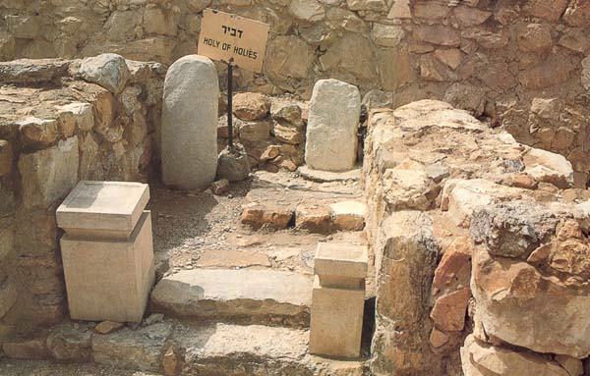
Israelite Temple to Yahweh Abolished by Josiah
The Israelite Temple to Yahweh: Steps flanked by limestone incense altars lead into a niche in the Holy of Holies at the Arad temple’s rear wall. In this four-foot by four-foot niche, two stone pillars (massevot) rise against the rear wall. The pillars and the incense altars are replicas, placed in position after the original artifacts were removed for safekeeping to the Israel Museum in Jerusalem.
When the Israelites built their first fortress (XI) at Arad in the tenth century B.C., they included a temple with a Holy of Holies. Through the centuries, as they modified their fortress, they preserved the temple. Finally, in the late seventh century B.C., the temple was abolished, during religious reforms by either King Josiah or King Hezekiah; the incense altars were reverently laid on their sides and were covered with earth.
Biblical Archaeology Review 13:2, March/April 1987
Arad—An Ancient Israelite Fortress with a Temple to Yahweh

Slide 24
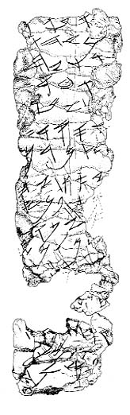
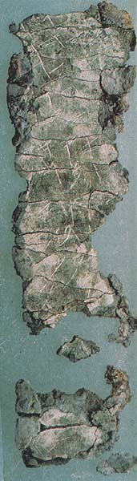
The Priestly Blessing
The most significant objects in the repository of Cave 4 were two small cylindrical scrolls of pure silver (the smaller scroll, with a drawing, is shown above).r When rolled, these scrolls have a hole running lengthwise through the center, allowing them to be hung around the neck as amulets. The larger one measures 4 inches by 1 inch, and the smaller one only 1.5 by .5 inches, when unrolled: Inside, they are both inscribed with about 18 lines of writing, including the following:
“May Yahweh bless and keep you;
May Yahweh cause his face to shine upon you and grant you peace.”
Biblical Archaeology Review 27:3, May/June 2001
Pagan Yahwism: The Folk Religion of Ancient Israel

Slide 25
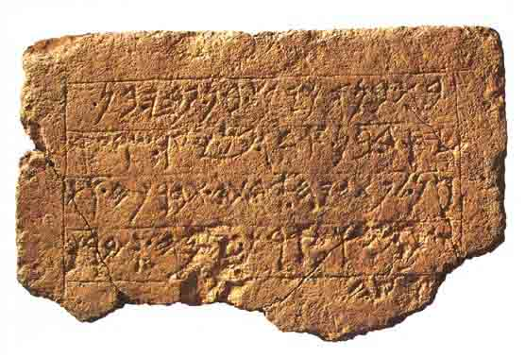
Ekron Inscription
The inscription calls on a goddess (her name is highlighted in the drawing) to bless king Achish and his land. It is significant that the formula used here, “May she bless him and keep him” (tbrkh vtsûmrh), is reminiscent of the first of the three Priestly blessings as recorded in the Bible (Numbers 6:24): “May the Lord bless you and keep you” (yevarekhekha YHWH veyishmerekha) and in the inscriptions discovered by Gabriel Barkay at Ketef Hinnom in Jerusalem.
“The temple (which) Achish son of Padi son of Ysd son of ’Ada’ son of Ya‘ir ruler of Ekron built for Pt[n]yh, his Lady. May she bless him and ke[e]p him and prolong his days and bless his [l]and.”
Biblical Archaeology Review 24:5, September/October 1998
Discovering a Goddess

Slide 26
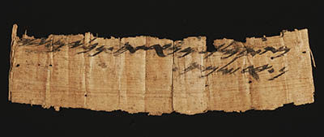
Jerusalem Papyrus
“From the female servant of the king, from Naharata (place near Jericho) two wineskins to Jerusalem.”
Significantly, this papyrus inscription had not been discovered on a scientific archaeological expedition, but rather had “appeared” on the antiquities market.
Bible History Daily The Jerusalem Papyrus and the forged words on it

Slide 27
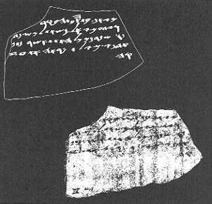
Lachish Letters
An inscribed ostracon records the death throes of Lachish, just before the Babylonians razed the city in 588/6 B.C. Twenty-one ostraca, written in clear Biblical Hebrew, were buried under the debris of the Level II outer gate guard room. Lachish Letter IV poignantly portrays the last days of Lachish in a letter from a soldier (Hoshaiah) at a settlement some distance from Lachish to his commander at Lachish (one Yaosh): “And let (my Lord) know that we are watching for the beacons of Lachish … we cannot see [the beacons from] Azekah.” Hoshaiah assumes that, since the beacons of Azekah no longer burn, it has already fallen. Azekah is just 11 miles northeast of Lachish. Jeremiah (34:7) records that Azekah and Lachish were the last Judean strongholds to be taken by the Babylonians.
Biblical Archaeology Review 5:6, November/December 1979
Answers at Lachish

Slide 28
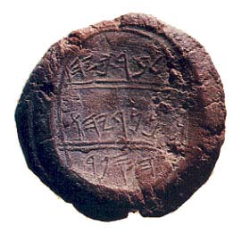
“Baruch, the Son of Neriyahu,
the Scribe”
Jeremiah’s scribe, Baruch, who plays a part in four Biblical episodes (Jeremiah 32:12, 43:1–7, and chapters 36 and 45), apparently owned the seal that made the impression in this bulla (a lump of clay bearing a seal impression). A bulla (plural, bullae) was affixed to the knot of a string used to bind scrolls, thus ensuring that no unauthorized person could open the document undetected.
This bulla is part of a hoard obtained on the antiquities market by a private collector. Several factors, however, strongly suggest its identification with the Biblical Baruch: The script is consistent with that used in Baruch’s time, the end of the seventh and beginning of the sixth centuries B.C.E.; the genealogy matches the Bible; the bulla is associated with another biblically connected bulla in the same hoard; and the bullae in the hoard are baked hard, as they would be if they were caught in the fiery destruction of Jerusalem in 587/586 B.C.E.
Biblical Archaeology Review 17:4, July/August 1991
Six Biblical Signatures

Slide 29
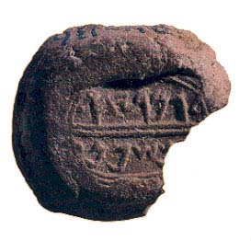
“Gemaryahu Son of Shaphan”
Unlike the bullae of Baruch and Yerahme’el, no doubt exists as to the authenticity of this bulla, which the late Yigal Shiloh excavated along with 50 others in the City of David. It reads: “Belonging to Gemaryahu / son of Shaphan.” Found in a stratum that securely dates it to shortly before the Babylonian conquest of Jerusalem in 587 / 586 B.C.E., about the same time as the events described in Jeremiah 36, this bulla can be identified with the Biblical Gemariah, mentioned in Jeremiah 36:10: “Baruch read the words of Jeremiah from the scroll, in the house of the Lord, in the chamber of Gemariah the son of Shaphan the scribe … ” The contraction of Gemaryahu to Gemariah parallels the contraction of Neriyahu to Neriah in Baruch’s seal.
Biblical Archaeology Review 17:4, July/August 1991
Six Biblical Signatures
Notes:
‹#›

Slide 30
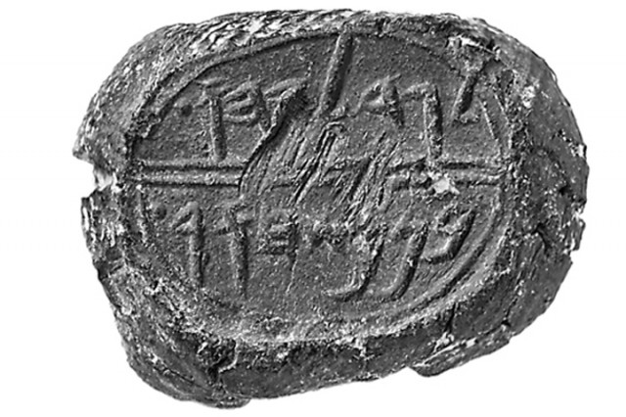
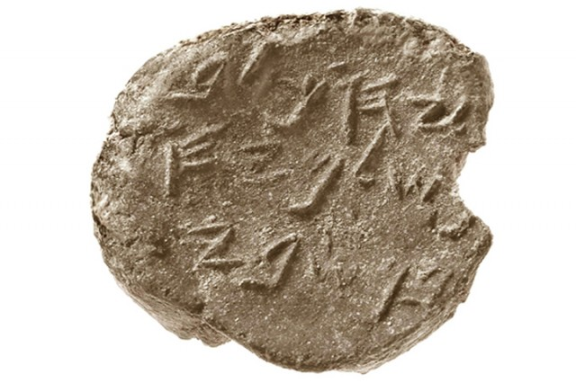
Jeremiah Is thrown into the pit by Gedaliah and Jehukal
Seal impressions (bullae) of two of the king’s courtiers mentioned in the book of Jeremiah were recently excavated—one (Gedaliah, son of Pashhur) was found in David’s palace itself, the other (Jehucal, son of Shelemiah, shown here) was found a few feet away. Both were courtiers in the reign of King Zedekiah (early sixth century B.C.E.), indicating that David’s palace was still in use at that time.
Biblical Archaeology Review 40:1, January/February 2014
The Interchange Between Bible and Archaeology

Slide 31
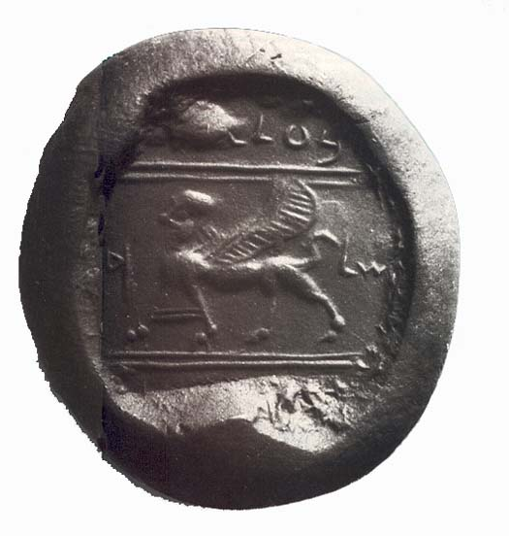
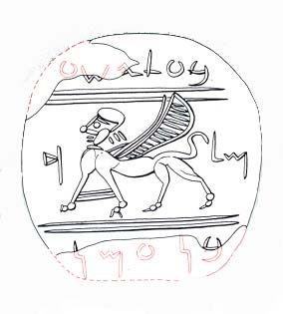
Seal of Ba’alis
“[Belonging to] Ba‘alis.” The word “king” flanks the winged sphinx at center, while the nearly indecipherable bottom line contains the partial first and last letters of the phrase “Sons of Ammon.”
The Bible describes the Ammonites as constant enemies from Israel’s earliest days in Canaan: “And the Ammonites crossed the Jordan to fight also against Judah and against Benjamin and against the house of Ephraim; so that Israel was sorely distressed” (Judges 10:9). Ba‘alis, the early sixth-century B.C.E. king to whom the seal belonged, continued this tradition of animosity when he dispatched an assassin to murder Gedaliah, the Babylonian-appointed governor of Judah. The assassination is commemorated even today in Jewish tradition by a yearly fast.
Biblical Archaeology Review 25:2, March/April 1999
Seal of Ba‘alis Surfaces

Slide 32
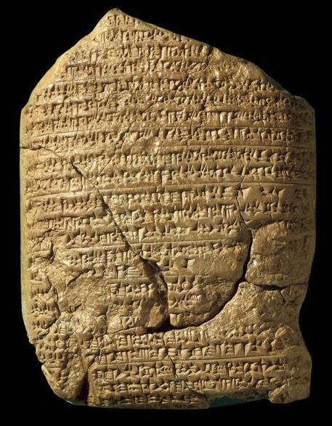
The Babylonian King Nebuchadnezzar
Nebuchadnezzar’s early years are detailed in this cuneiform tablet, part of the Babylonian Chronicle. The tablet covers events between 605 and 594 B.C.E. Each entry recounts military events in successive regnal years of the Babylonian kings. Horizontal lines separate the events by year. The fifth section of this tablet documents the conquest of Jerusalem and Judah and corroborates the Biblical account of Judahite royalty being taken into exile (2 Kings 25:30; Jeremiah 52:31–34).
Biblical Archaeology Review 42:5, September/October 2016
How Bad Was the Babylonian Exile?
Notes:
‹#›

Slide 33
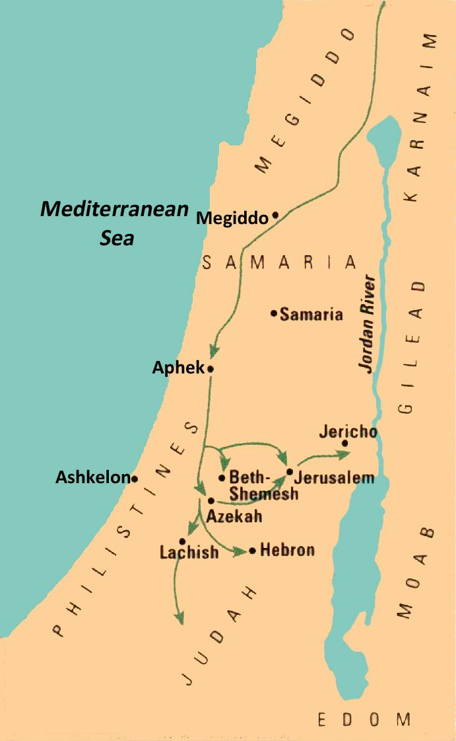
The Campaigns of Nebuchadnezzar
Into the
Holy Land
Biblical Archaeology Review 25:4, July/August 1999
Caught Between the Great Powers

Slide 34
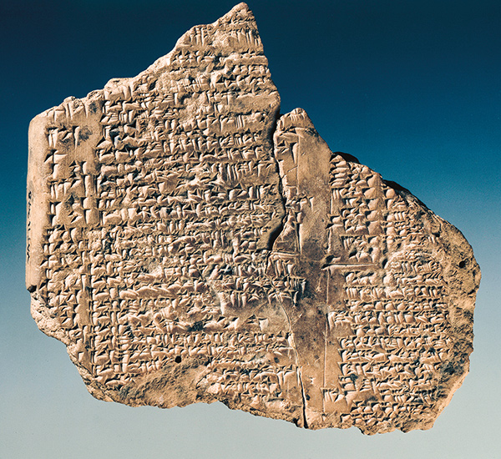
King Jehoaichin of Judah
This cuneiform ration list from the South Palace in Babylon is one of several confirming that Judean exiles were provided for in their captivity. The clay tablet, which measures 3.5 by 4 inches, dates between 595 and 570 B.C.E.
These texts preserve the names and titles of Levantine kings and high officials deported along with Jehoiachin.
Biblical Archaeology Review 42:5, September/October 2016
How Bad Was the Babylonian Exile?
Notes:
‹#›

Slide 35
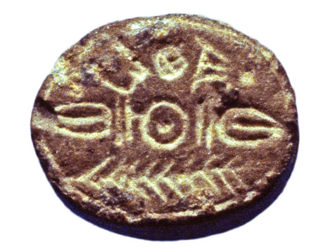
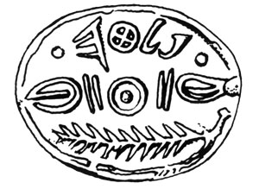
King Zedekiah of Judah
The upper register of this seventh- or early-sixth-century B.C.E. seal is inscribed in ancient Hebrew script with the name “Palta”. The lower register depicts the pointed fronds of a palm branch. Separating the two registers is a lotus bud design, a common decorative element on late Judahite seals. The name Palta is a short form of the name Pelatyahu, or Pelatiah in English. The latter appears in the Bible as the name of a high governmental official under King Zedekiah, the last king of Judah (Ezekiel 11:1, 13).
Biblical Archaeology Review 35:4, July/August September/October 2009
The Riches of Ketef Hinnom
Notes:
‹#›

Slide 36
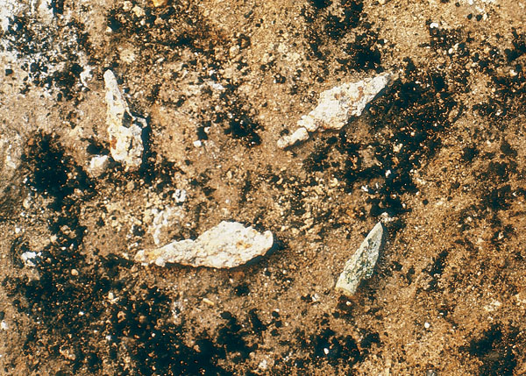
The Babylonian Conquest and the Destruction
of the First Temple
Iron Arrowheads used during the siege of Jerusalem were buried in a layer of soot and ash surrounding the tower. The three-edged arrowhead is the bronze Scytho-Iranian type used by the Babylonian army.
Biblical Archaeology Review 35:4, July/August September/October 2009
Ten Top Discoveries
Notes:
‹#›

Slide 37
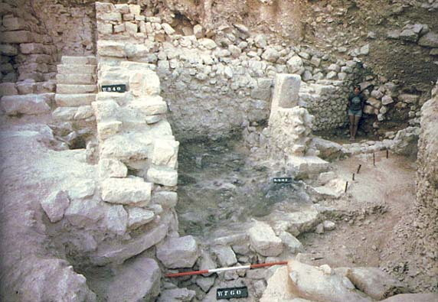
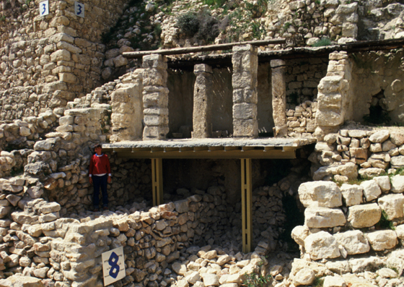
Babylonian Destruction of Ahiel’s House at the City of David
The Burnt Room: Dramatic evidence of Jerusalem’s destruction by Nebuchadnezzar and the Babylonians in 586 B.C., a thick layer of dark ash covers this small Iron Age building at the base of the stepped structure.
Ahiel’s house, so named because an inscription including the name was found inside, is a four-room house.
Biblical Archaeology Review 14:3, May/June 1988
BAR Interview: Yigal Shiloh—Last Thoughts, Part II
Biblical Archaeology Review 11:6, November/December 1985
The City of David After Five Years of Digging

Slide 38
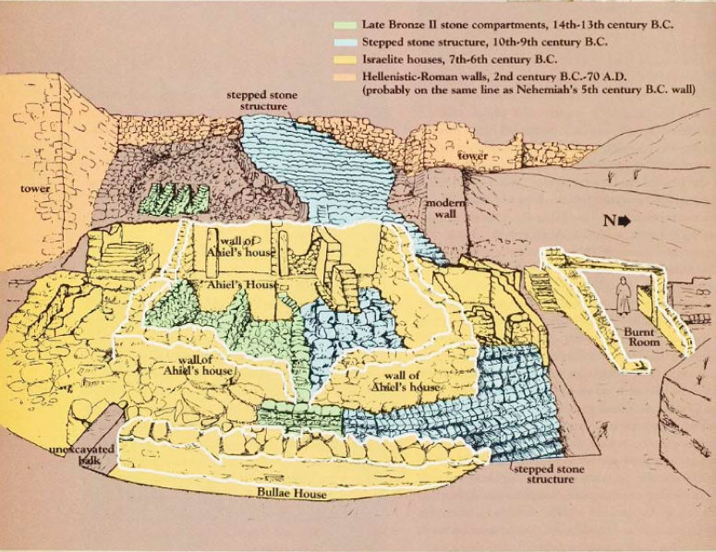
Ahiel’s House
Biblical Archaeology Review 11:6, November/December 1985
The City of David After Five Years of Digging

Slide 39
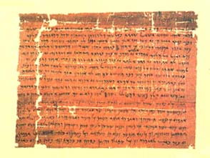
Jewish Community
in Egypt
There was a Jewish temple on Elephantine in the sixth and fifth centuries B.C.E., where sacrifices, including animal sacrifices, were offered.
Biblical Archaeology Review 21:3, May/June 1995
Did the Ark Stop at Elephantine?
In this draft letter dated November 25, 407 B.C.E., Jedaniah, leader of Elephantine’s Jewish community, and his priestly colleagues ask Bagohi, the governor of the Persian province of Judah, to intercede on their behalf for the rebuilding of their temple:

Slide 40
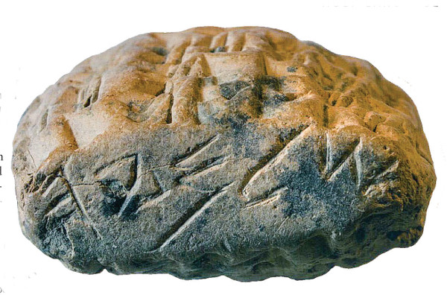
Al- Yahudu Tablets
Documents of Exiled Judeans in Babylonia
Biblical Archaeology Review 43:1, January/February 2017
How Hebrew Became a Holy Language
This promissory note from Al-Yahudu, also known as Judahtown, in Babylonia is inscribed with a Yahwistic name, Shelemyah, in paleo-Hebrew script. The exiles continued to use Hebrew for generations despite being displaced.

